Slide 1
Credit Card Transaction Dashboard An Interactive Analysis Of Financial Transaction & Customer Insights
-Sonali Pawar

Slide 2
Project Objectives
The objective of this project is to develop an interactive dashboard that provides comprehensive analysis of credit card financial performance and customer insights.
Identify revenue trends across quarters(Q1-Q4).
Understand customer behavior based on education, income, and job.
Compare revenue across card categories and usage methods( Exp-type, Educational-level, Card category, use chip).
Find revenue of male, female by week-wise.
Enable data-driven insights through interactive visuals and slicers.
This dashboard enables a data-driven understanding of credit card usage, and improving customer targeting.

Slide 3
Data Overview
The Dataset contains two tables credit_card.csv and customer.csv, containing information about credit card transactions and customer profiles.
Dataset Highlights:
Revenue – 55M
Interest – 7.84M
Average css – 3.19
Transactions – 656K
Key Fields:
Credit_card: ClientNum, Total_Trans_Amt, Total_Trans_vol, Interest_Earned, Annual Fees, Week_Start_Date, Use_chip, Card_category.
Customer: Client_num, Customer_Age, Gender, Income, Education_level, customer_job, Marital_status.

Slide 4
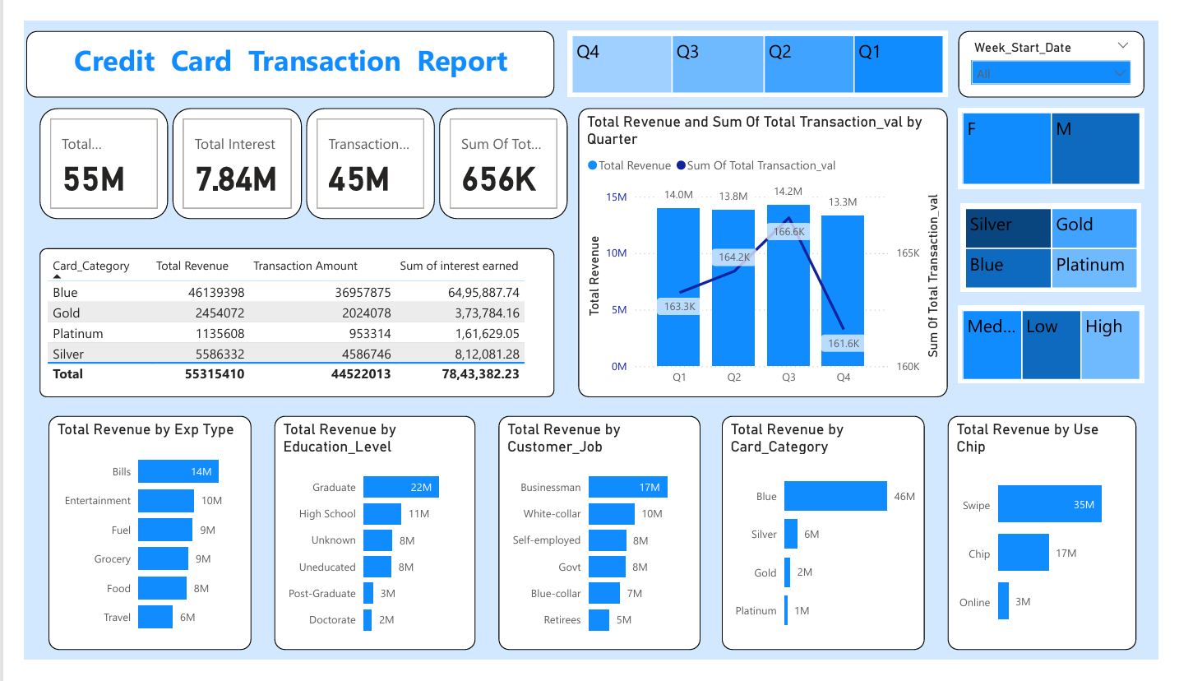

Slide 5
Transaction Report
Dashboard Structure
Transaction dashboard provides a comprehensive
View of credit card usage patterns and revenue trends.
It provides a broad view of how revenue and transaction
volumes vary across different dimensions.
Key Elements:
KPI Cards: Total Revenue, Intrest, Transaction_val
Card Categories: Blue, Gold, Platinum, Sliver
Trends: Revenue & Transaction volume by Quarter
Demographics & usage Analysis:
Revenue by Exp_Type, Educational_level, Job, Card_category, Use Chip
The report is prepared with Treemap for Quarters, Gender, Card Type, Income Group,
and week start date to enable dynamic filtering.

Slide 6
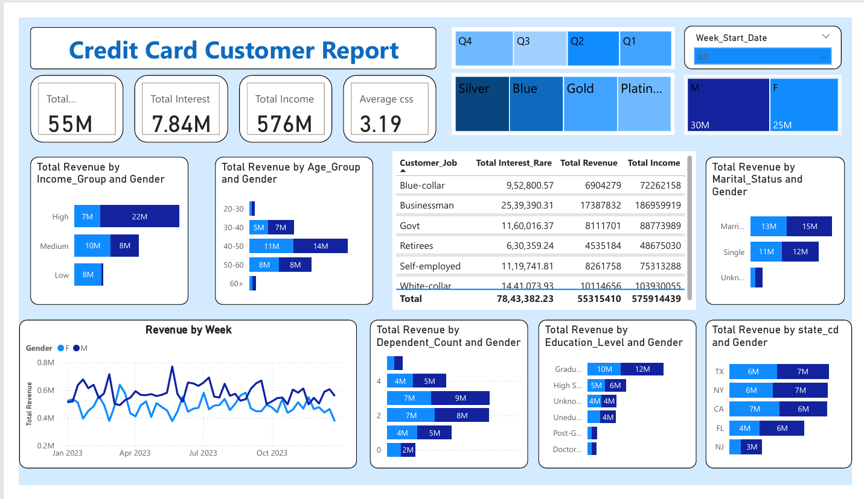

Slide 7
Customer Report
Dashboard Structure
This Customer Overview dashboard provides a detailed visual analysis of customer profiles based on education, income, age, gender, job, and marital status, and job type to understand which groups contribute most to revenue.
Key Elements:
KPI Card: Revenue, Interest, Income, and CSS (Customer Satisfaction Score)
Customer Segment Table: Job-wise Revenue, Interest and Income
Behavioural Patterns:
Revenue by Age, Income Group, Marital Status, Education, Departments and
state
Revenue Trends over week
Treemap are available for Quarters, Gender, Card type, and Week_Start_Date, Providing interactive filtering.

Slide 8
Key Matrices
Our dashboard presents key performance indicators that provides a quick snapshot of the credit card business performance. These metrices are displayed as KPI cards across both reports for quick analysis.
Finanacial Metrices :
Total Revenue : 55M
Total Interest Earned: 7.84M
Total Transaction Amount: 45M
Total Income: 576M
Volume Metrices :
Transactions count:656K
Customer Satisfaction Score(CSS):3.19

Slide 9
Key Metrics
Filter Capabilities:
Customer and Transaction Both Report aloow filtering:
Time Period(Quarter/Week_Start_Date)
Financial Attributes(Card-Category, Income-Group)
To Focus analysis on specific customer segments and understand how different groups contribute to revenue, behavior, and performance.

Slide 10
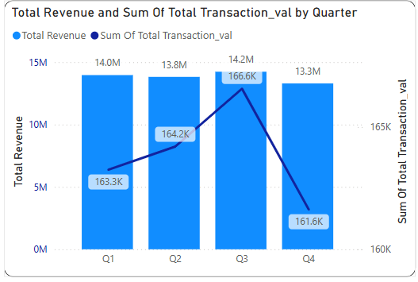
Quarter-wise Revenue & Transaction Volume
This visual compares Total Revenue(bar chart) and Total Transaction Volume(line chart) across each quarter(Q1-Q4).
Both Revenue and Transaction Volume peaked in Q3 with 14.2M and 166.6K.
This chart helps analyze how revenue and customer activity change across quarters. It supports better planning by highlighting the strongest and weakest quarters in terms of performance.

Slide 11
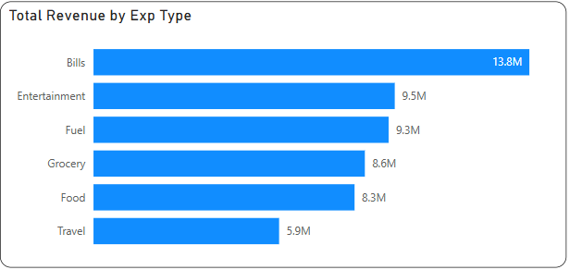
Revenue by Expenditure Type
This bar chart shows the Total Revenue generated from different types of customer spending.
The highest revenue comes from bills (13.8M) followed by Entertainment (9.5M), & Fuel (9.3M)
Other categories like Grocery, food, and Travel also contribute significantly.
This analysis helps to understand which spending categories drive the most credit card revenue.

Slide 12
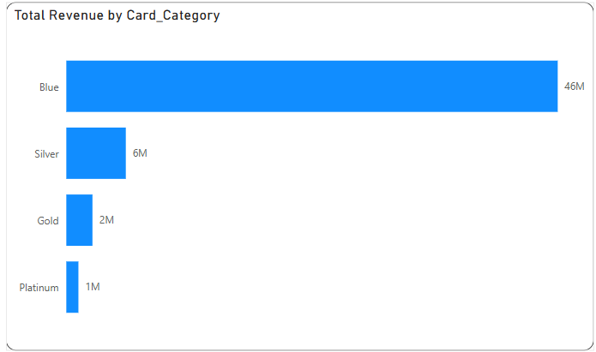
Revenue by card category
This bar chart displays the total revenue generated by each credit card category.
The Blue card category contributes the most, generating 46M in revenue.
other categories like silver (6M),Gold(2M), and platinum (1M)contribute Comparitively less.
This analysis shows that the majority of revenue comes from Blue card users, indicating their high usage or larger customer base.

Slide 13
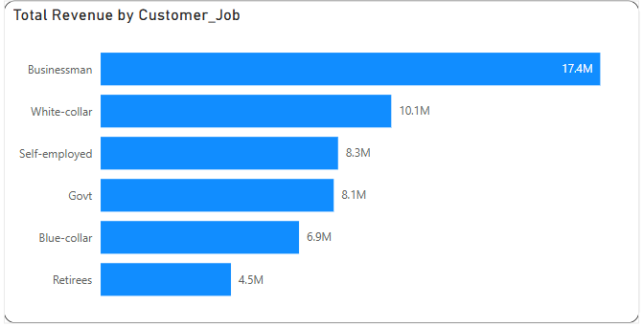
Revenue by Job
Businessmen contribute the highest revenue at 17.4M,followed by White-collar(10.1M and Self employed(8.3M) individuals.
The lowest revenue comes from Retires, at round 4.5M.
This insights helps to understand which job groups are the most valuable for revenue generation, supporting targeted marketing and planning.

Slide 14
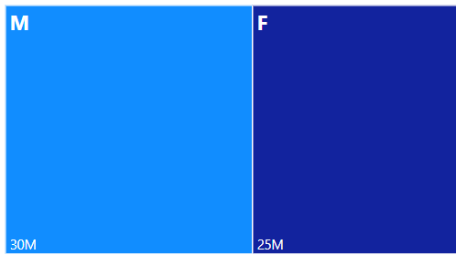
Revenue by Job
Male customers contribute about 30M in total revenue.
Female customers contribute around 25M.
The chart helps to identify that male users generate slightly more revenue than female users, provide insights for targeted marketing strategies.

Slide 15
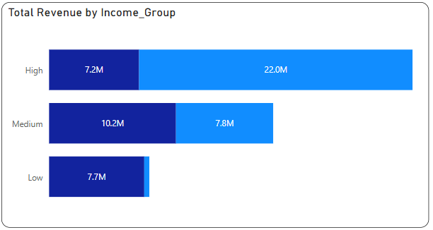
Revenue by Income Group
High-income group dominates overall revenue, driven primarily by males(22M) and females contribute(7.2M).In the medium Income-Group, females slightly perform males. Among the low-income group, females show a significantly higher contribution(9.69M) compared to males.

Slide 16
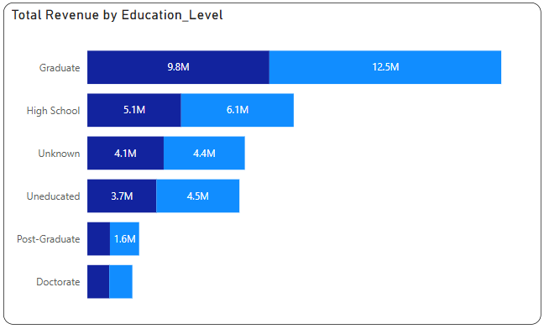
Revenue by Educational-level
Graduates lead in revenue, with males contributing 12.5M and females 9.8M. High school level follows, with a near-equal gender split 6.1M males, 5.1M female). Post-Graduate and Doctorate level show the lowest revenue, with similar contributions from both genders.

Slide 17
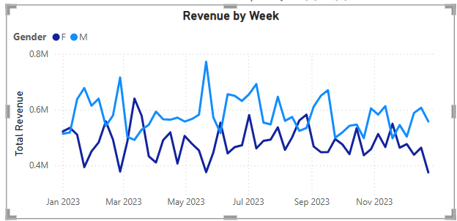
Weekly Revenue Trend
Weekly revenue peaked on May 21,2023, with Male revenue at7.71M and Female revenue at 3.76M. Overall, male revenue consistently exceeds female revenue. While there are changes, the revenue trend remains relatively stable throughout the year, without major spikes or drop outside of the peak week.

Slide 18
Key Insights From(Transaction Report)
Total Revenue generated is approximately 55M, mainly driven by transaction amounts and interest earned and Annual fees.
The Blue card category generated the highest revenue (46M), Making it the most valuable card type
Businessmen contributed the most to revenue (17.4M), followed by white-collar employees (10.1M).
Male customers contributed slightly more (30M) compared to female customers(25M).
Bills and Entertainment are the top spending categories, each generating 12.8 and 9.5M respectively.
Customers with graduate degrees and income levels generated more revenue.
Quarter3 (Q3) recorded the highest revenue , showing a strong performance during that period.

Slide 19
Key Insights From(Customer Report)
Male customers contribute slightly higher to total revenue (30M) compared to female customers (25M).
Customers in the medium-income group generates the highest revenue, followed by the low-income group.
Businessmen are the top revenue contributors (around 17.4M). Other high contributors include White-collar employees and Self-employed customers.
Customers with a Graduate or Post-Graduate education show higher revenue generation.
The Blue Card is the most widely used, contributing the highest revenue.
Weekly trend shows stable revenue throughout the year, peaking on May 21, 2023, with consistent Male dominance in revenue.

Slide 20
Business Value
Helps banks and financial institutions to understand which customer segments(by job, gender, income, education)contribute the most revenue – allowing for better targeting.
Revealed Blue Card holders as the most valuable group, guiding future card promotion strategies.
By analyzing card categories, expenditure type, and Quarter-wise trends, the business can design personalized offers and campaigns to boost usage.
Understanding usage patterns and satisfaction (CSS) enables the bank to improve customer experience, leading to better customer loyalty.
Gender-based revenue analysis helps in designing campaigns aimed at increasing Female engagement, especially in underperforming segments.
Stable weekly revenue trend enables better forecasting and resource planning.

Slide 21
Conclusion
This project successfully shows how Power BI can be used to uncover deep insights from financial and customer data.
The dashboards offer clear visibility into key revenue drivers, customer behaviors, and transaction trends.
These insights can support data-driven decision-making across making across marketing, product strategy, and customer targeting.
The project reflects strong visual storytelling, efficient use of Power BI features, and an understanding of business context through analytics.

Slide 22
Thank You

